Slide 1

AI based Healthcare Management System
Group No. 7
Pranav Iyer: 16104002
Shefali Rane: 16104003
Bhaskar Khekale: 16104026
Project Guide : Mrs Rujata Chaudhari
Co-Guide : Mrs Geetanjali Kalme

Slide 2
Contents
Introduction
Objectives
Problem Definition
Technological Stack
Review Suggestion
Proposed System Architecture/Working
Prototype Design Demonstration
Plan of Paper Publication

Slide 3
Introduction
In the current existing system the patient details, doctor availability details, tests undergone , medicines prescribed by the doctor is maintained manually by the receptionist in some random notebook.
This particular proposed system is aimed at developing a solution where the cross platform application will help the Doctors to run their clinics in a better way .

Slide 4
Objectives
To design a system for better patient care which can be used across different platforms.
To enhance the UI and operability.
To store the patient medical records in a better and organized manner for future references.
To fetch the data on local database will become very tedious to manage, hence making use of a cloud server.

Slide 5
Problem Definition
The proposed system is a solution to solve this problem, an internet based platform which will store the patients information in an organized manner. If any doctor wants to check the details regarding their patient’s last visit, then all they have to do is take a quick glance through the patients profile in the application.

Slide 6
Technological Stack
Software and Hardware Requirement Specifications:
Languages: Java Script, HTML.
Devices: Windows.
Data Storage: Aws Cloud Server.
Databse: php,mysql server,xampp.

Slide 7
Review Suggestions
Focus on specific objectives.
Proposed System workflow using Dia Tool.
Proper communication between both modules.
Mention techniques for multilingual system.

Slide 8
Proposed System
The proposed solutions that we are going to deploy here is to speed-up the database response by using a Cloud Server platform rather than a local database and to reduce the time complexity by using multi-user environment. Because of this multi user environment we can reduce the burden on single person.
The system after careful analysis has been identified to be presented with the following modules:
Doctor Module
Patient Module

Slide 9
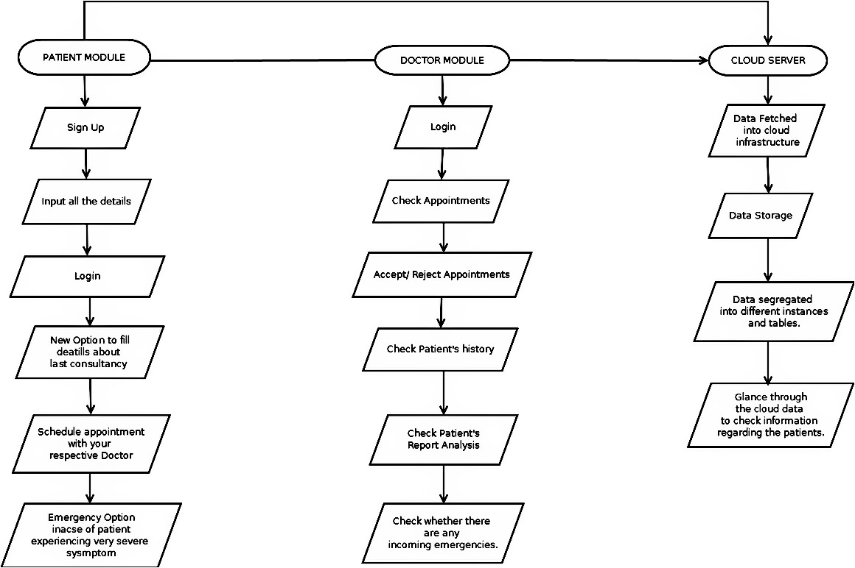
Workflow Diagram(Proposed System)

Slide 10
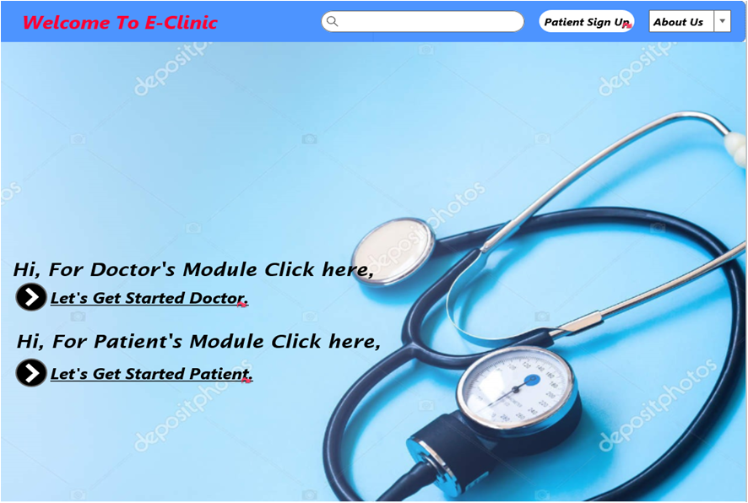
Prototype Design Demonstration
Homepage:

Slide 11
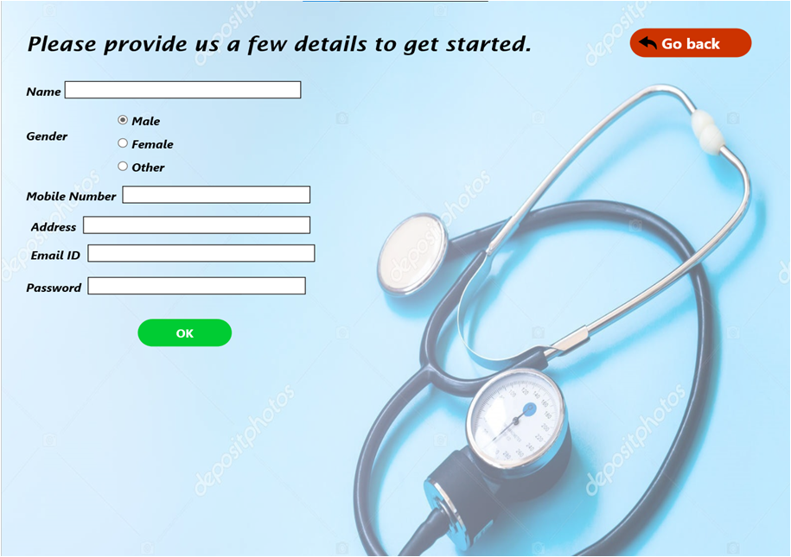
Patient Module:

Slide 12
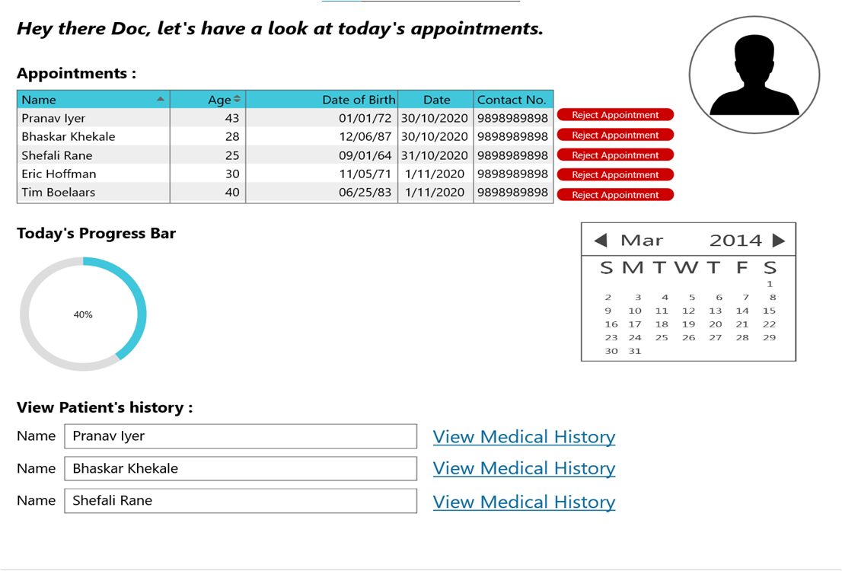
Doctor Module:

Slide 13
Plan of Paper Publication
Paper draft is ready , working on plagiarism check and planning to publish in conference suggested by guide.
http://ieeepune.i2ct.in/call-for-papers/#1570448337628-840fb5d7-fb05

